Slide 1
Rubik’s Cube+: A self-supervised feature learning framework for 3D medical image analysis Jiuwen Zhu, Institute of Computing Technology, Chinese Academy of Sciences Yuexiang Li, Tencent Jarvis Lab Yifan Hu, Institute of Computing Technology, Chinese Academy of Sciences June 2020, Medical Image Analysis

Slide 2
Background
Supervised Learning: Large amount of labeled data.
Unsupervised Learning: Clustering with unlabeled data.
Semi-supervised Learning : Small amount of labeled data.
Self-supervised Learning : Unsupervised Learning. Using pretext to help learn semantic image features to initialize the subsequent task.

Slide 3
Introduction
Jigsaw puzzles: re-assemble the separated and mixed tiles.
Rubik’s cube: cube ordering and cube orientation(previous work).
Rubik’s cube+: Rubik’s cube + masking identification.
3D data: Recover Rubik’s cube.
Main purpose: Leverage more spatial info & yield more robust feature.

Slide 4
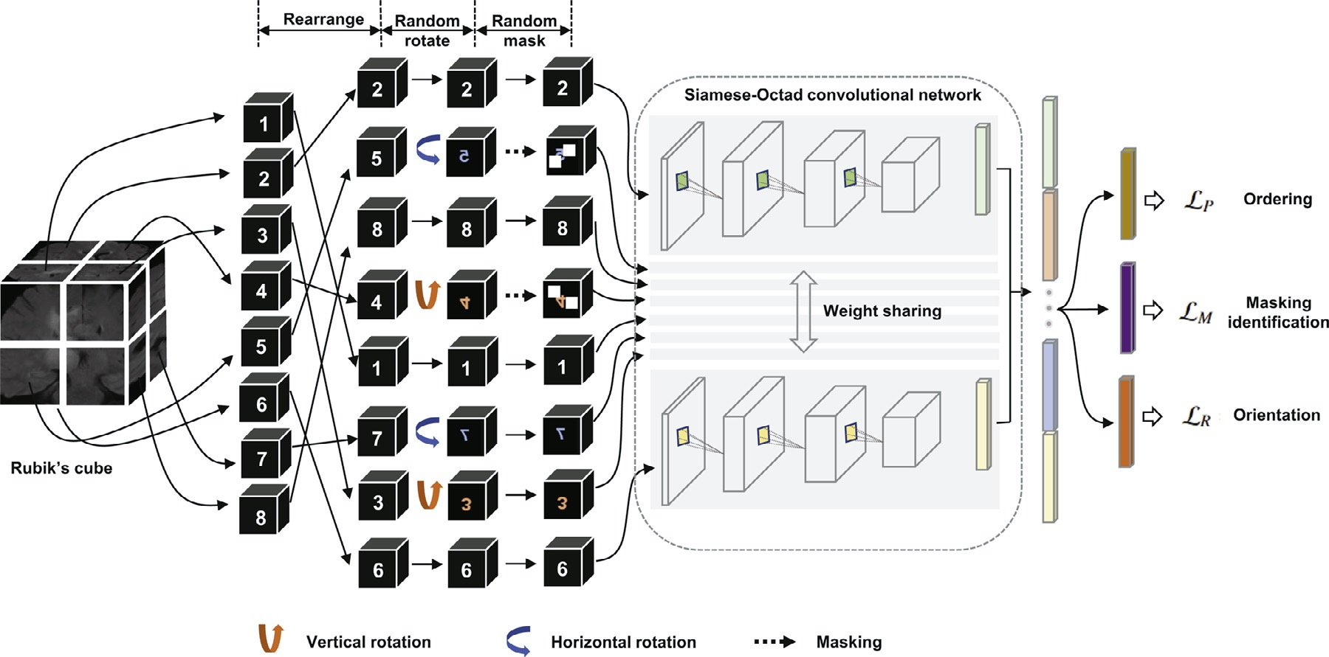
Method
Notes:
RP Shortcomings：1.relative position has multi result. 2.CNN learn trivial features. 3. not whole picture.

Slide 5
Method
Notes:
RP Shortcomings：1.relative position has multi result. 2.CNN learn trivial features. 3. not whole picture.

Slide 6

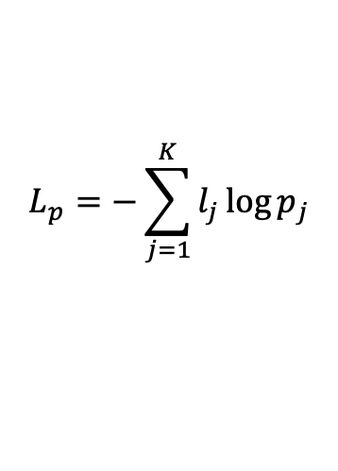


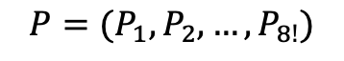
Method
Data Preprocess: Gap between 2 adjacent cubes. Normalized to [-1,1].
Cube Ordering: Rearrange to 2×2×2. The permutation of it is :
$$P=(P_{1},P_{2},…,P_{8!})$$
Select $K$ permutaions with Hamming distance from $P.$
Loss: cube ordering is seen as a classification task with $K$ categories.
$$L_{p}=−\sum_{j=1}^{K}{l_{j}\log{p_{j}}}$$
Where $l_{j}$ represents one-hot ground-truth and $p_{j}$ represents predictions.
Notes:
RP Shortcomings：1.relative position has multi result. 2.CNN learn trivial features. 3. not whole picture.

Slide 7
Method
Notes:
RP Shortcomings：1.relative position has multi result. 2.CNN learn trivial features. 3. not whole picture.

Slide 8
Method
Data Preprocess: Gap between 2 adjacent cubes. Normalized to [-1,1].
Notes:
RP Shortcomings：1.relative position has multi result. 2.CNN learn trivial features. 3. not whole picture.

Slide 9
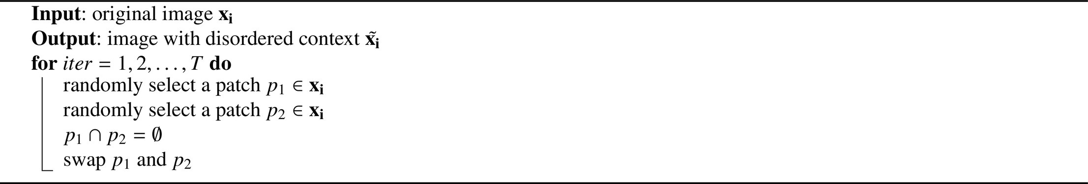
Method-CR
Context Restoration: Randomly select two isolated small patches and swap.
Major Features: 1. Simple, 2. Useful for different types of subsequent task, 3. Learn semantic features.
Experiment: Validate in classification, localization, and segmentation.

Slide 10
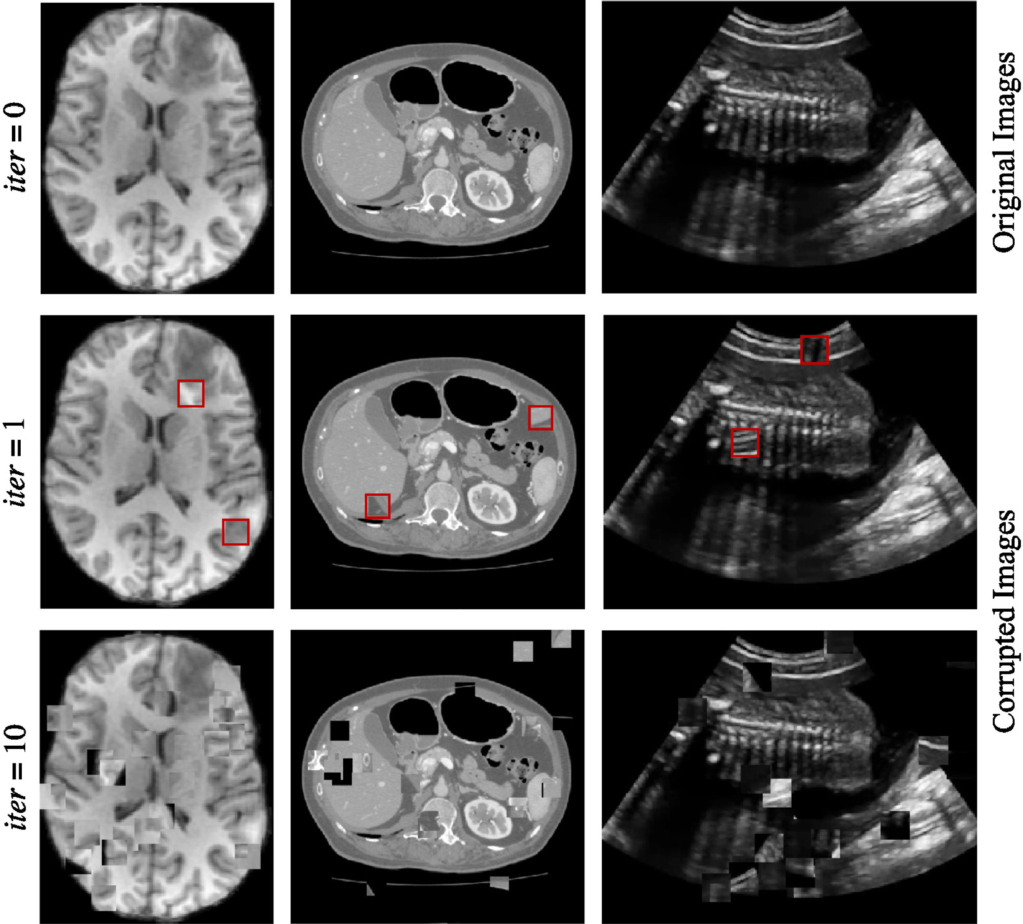
Method-CR
Generating training images for self-supervised context disordering:
Brain T1 MR image,
Abdominal CT image
2D fetal ultrasound image, respectively.

Slide 11
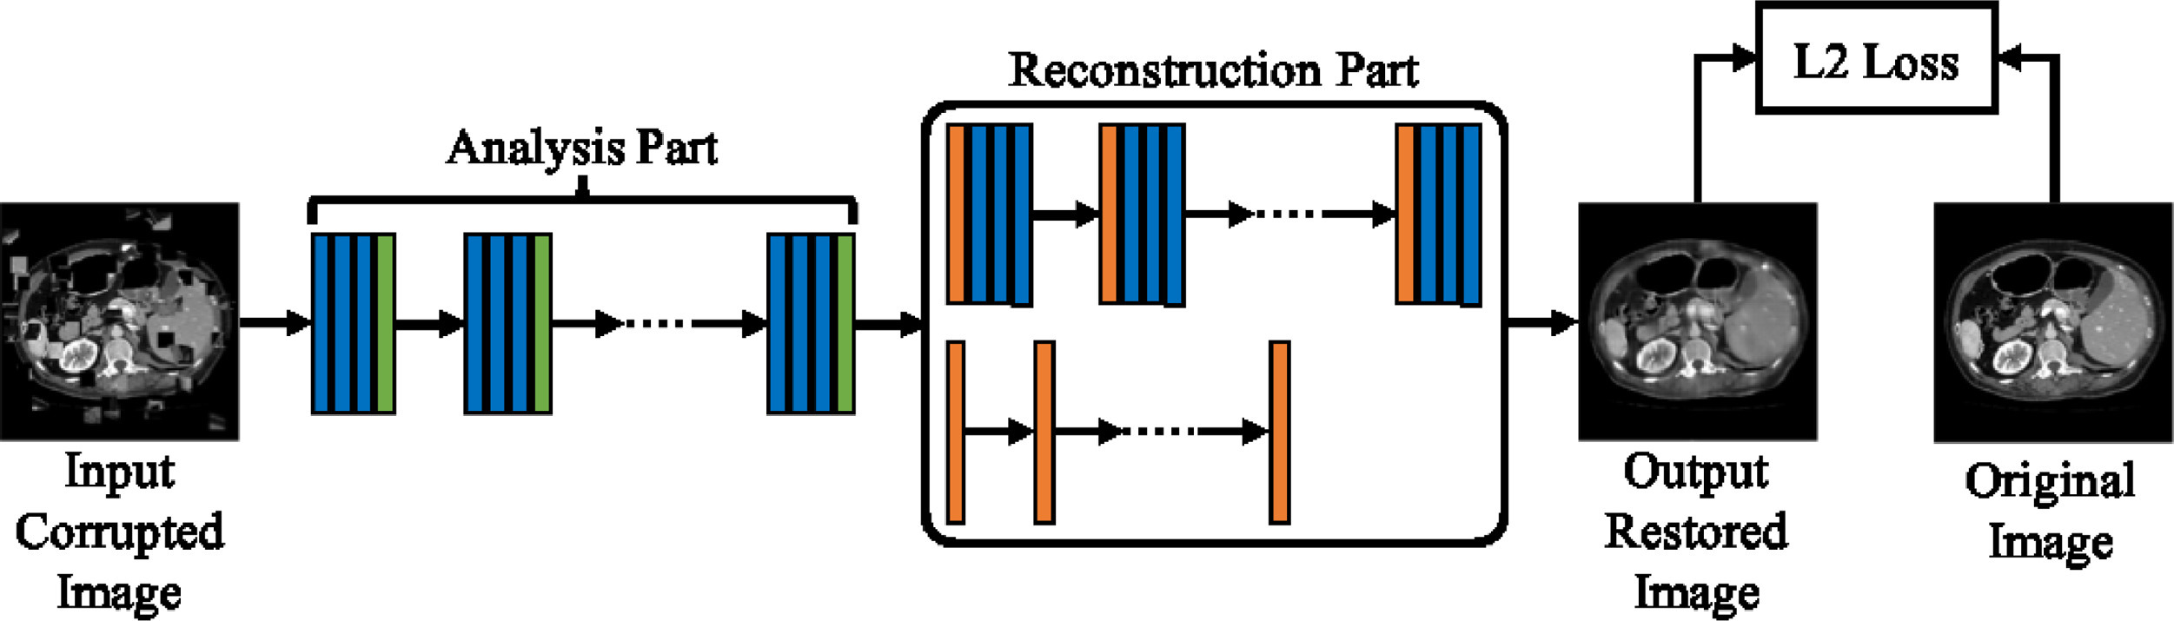
Method-Network Architectures
Analysis Part: Conv + Downsampling. E.g. ResNet,DenseNet,Inception.
Reconstruction Part: Deconv + Upsampling.
Notes:
RP Shortcomings：1.relative position has multi result. 2.CNN learn trivial features. 3. not whole picture.

Slide 12
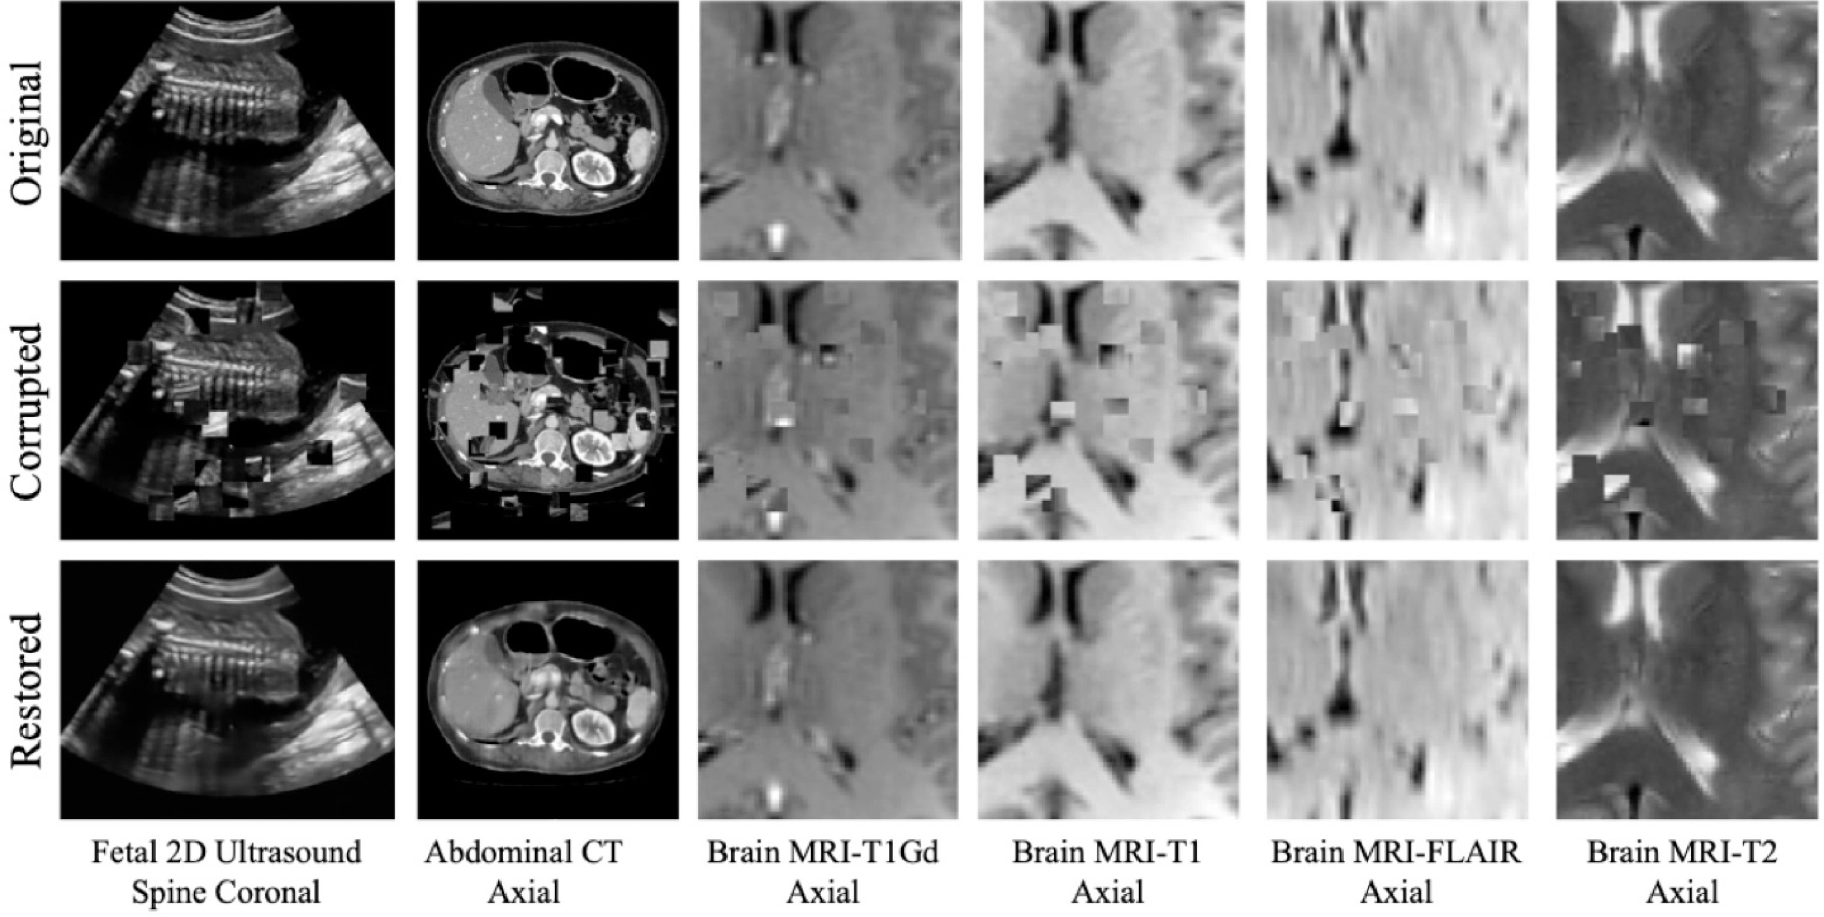
Experiment-CR
Analysis Part: VGG.
Result: Image blur(L2 loss function).
Notes:
RP Shortcomings：1.relative position has multi result. 2.CNN learn trivial features. 3. not whole picture.

Slide 13
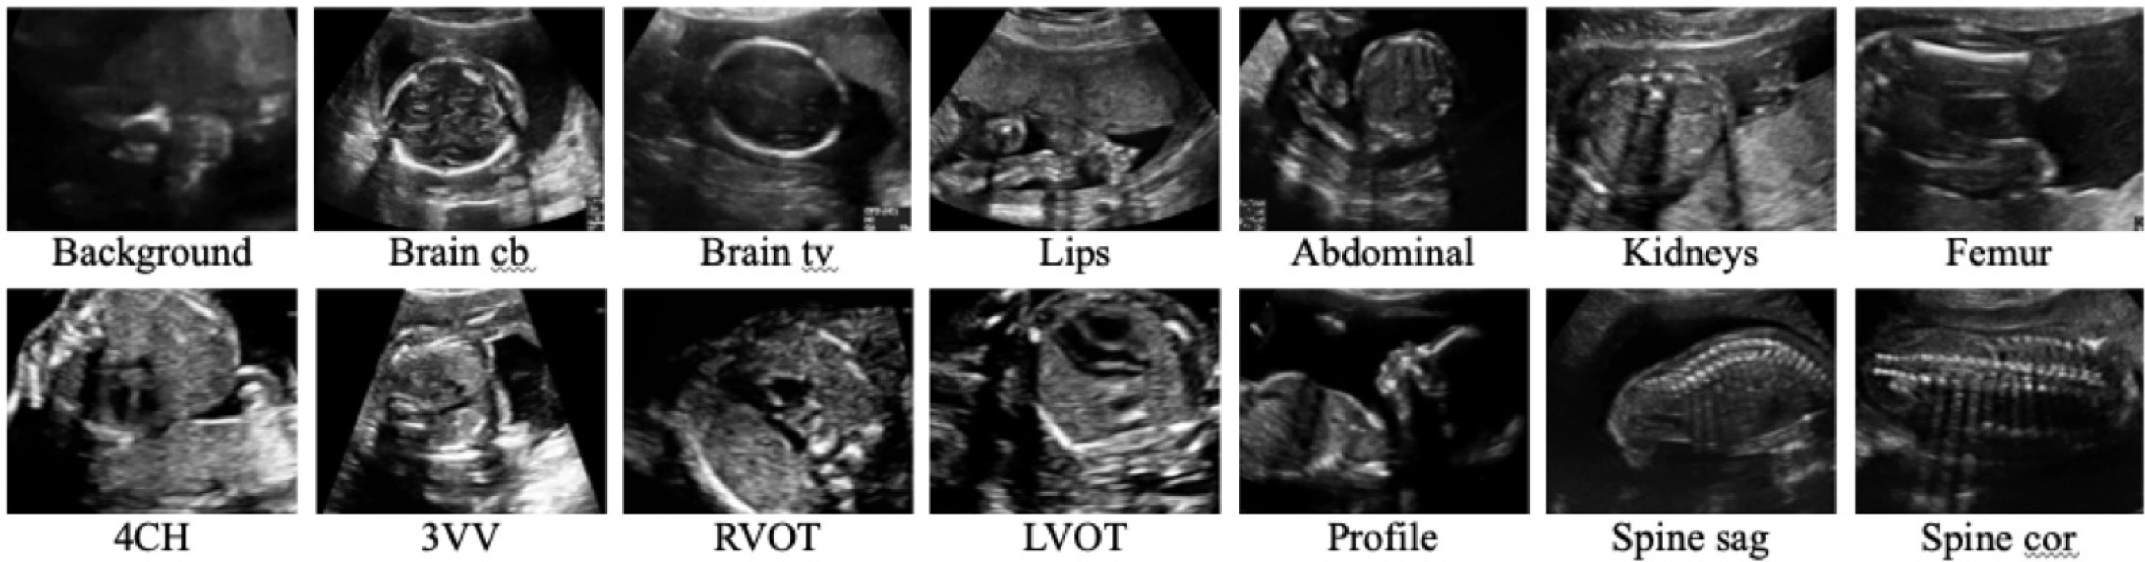
Experiment-Fetal Standard Scan Plane Classification
Network: SonoNet-64.
Dataset: 2694 2D ultrasound.
Implementation: each batch consists of two images from each of the standard scan plane cat- egories and 26 images from background images.
Notes:
RP Shortcomings：1.relative position has multi result. 2.CNN learn trivial features. 3. not whole picture.

Slide 14
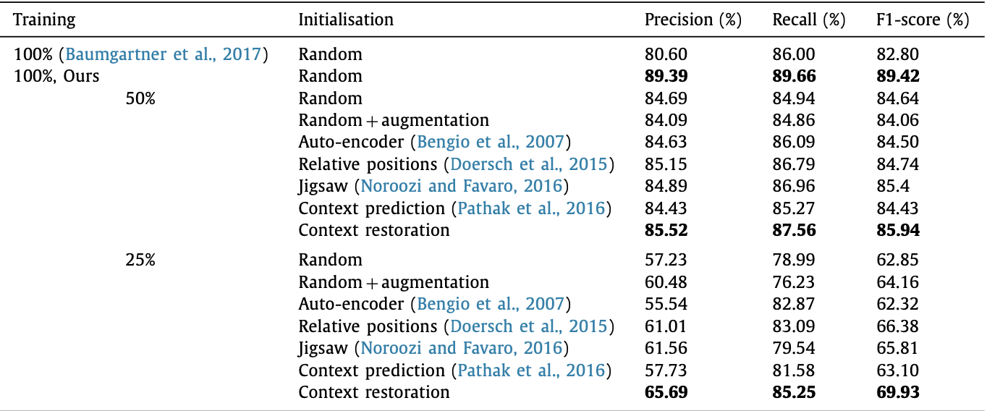
Experiment-Fetal Standard Scan Plane Classification
Less data leads to worse results.
Data Augmentation does not make improvement when training on half data but obvious a quarter of data.
SSP helps improve the result and CR is most useful.
Notes:
RP Shortcomings：1.relative position has multi result. 2.CNN learn trivial features. 3. not whole picture.

Slide 15
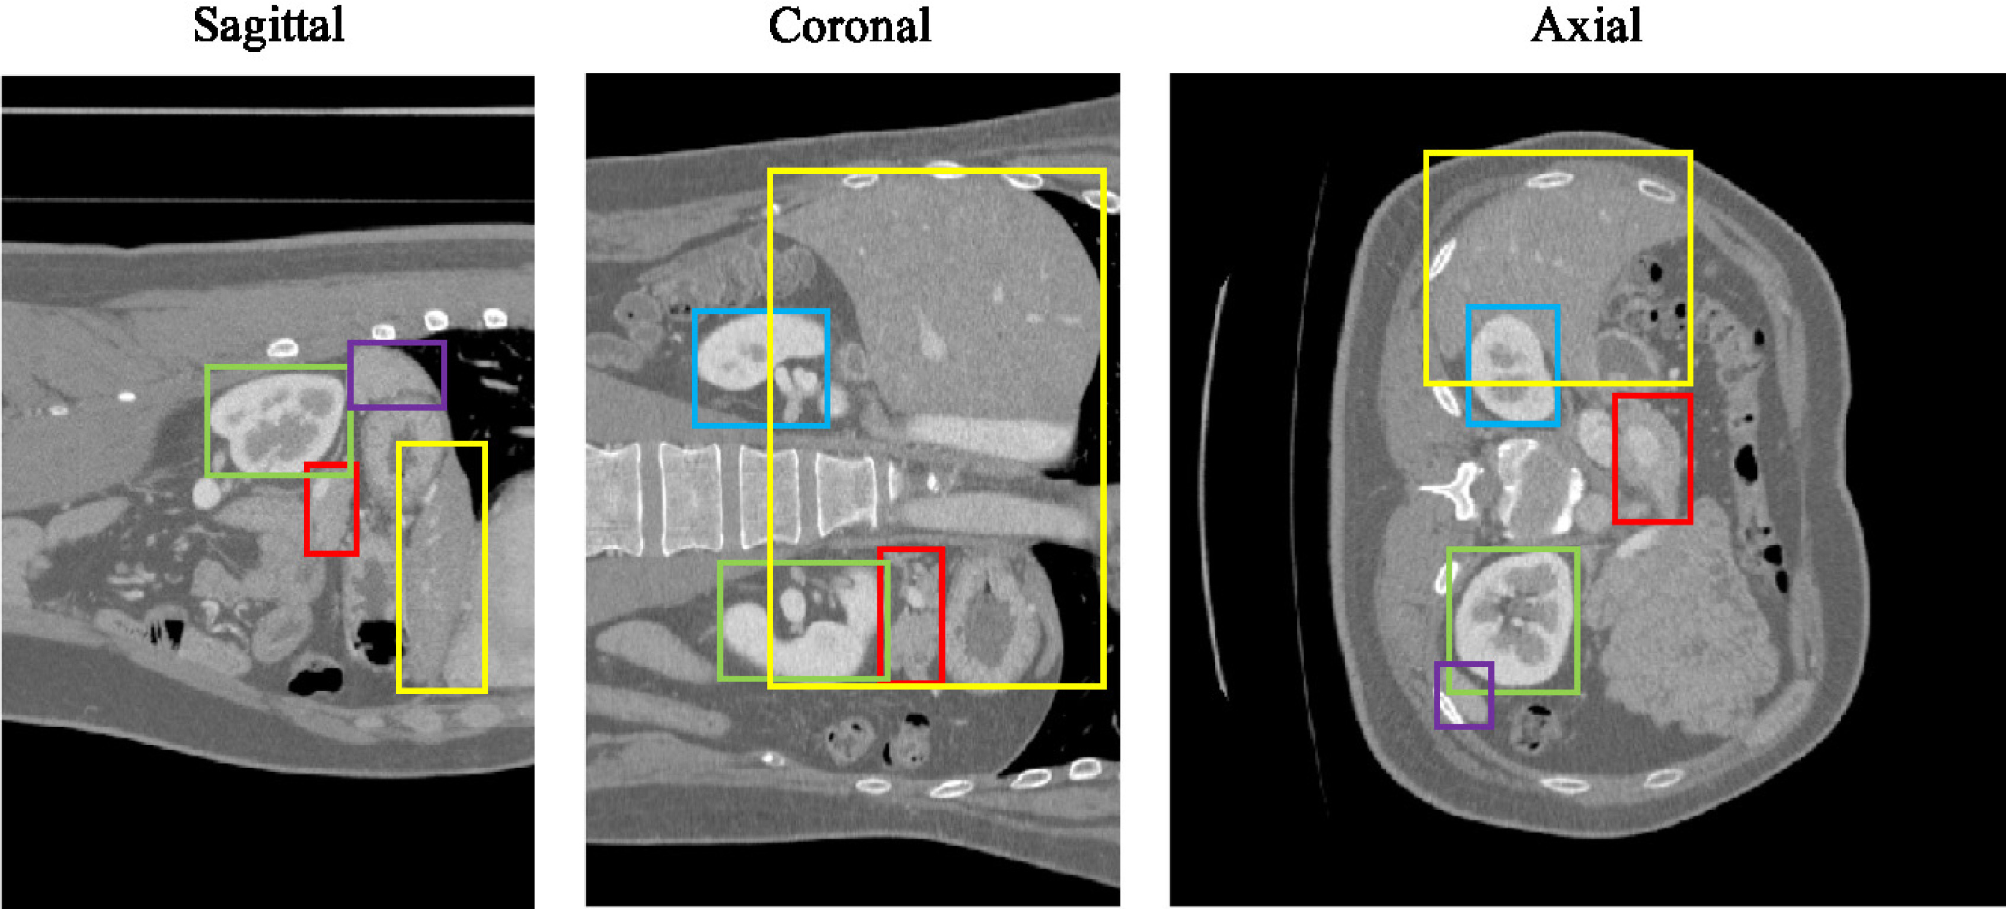
Experiment-Abdominal Multi-Organ Localization
Network: More layers.
Dataset: 3D abdominal CT image from 150 subjects.
Implementation: each batch consists of two images from each of the standard scan plane cat- egories and 26 images from background images.
Notes:
RP Shortcomings：1.relative position has multi result. 2.CNN learn trivial features. 3. not whole picture.

Slide 16
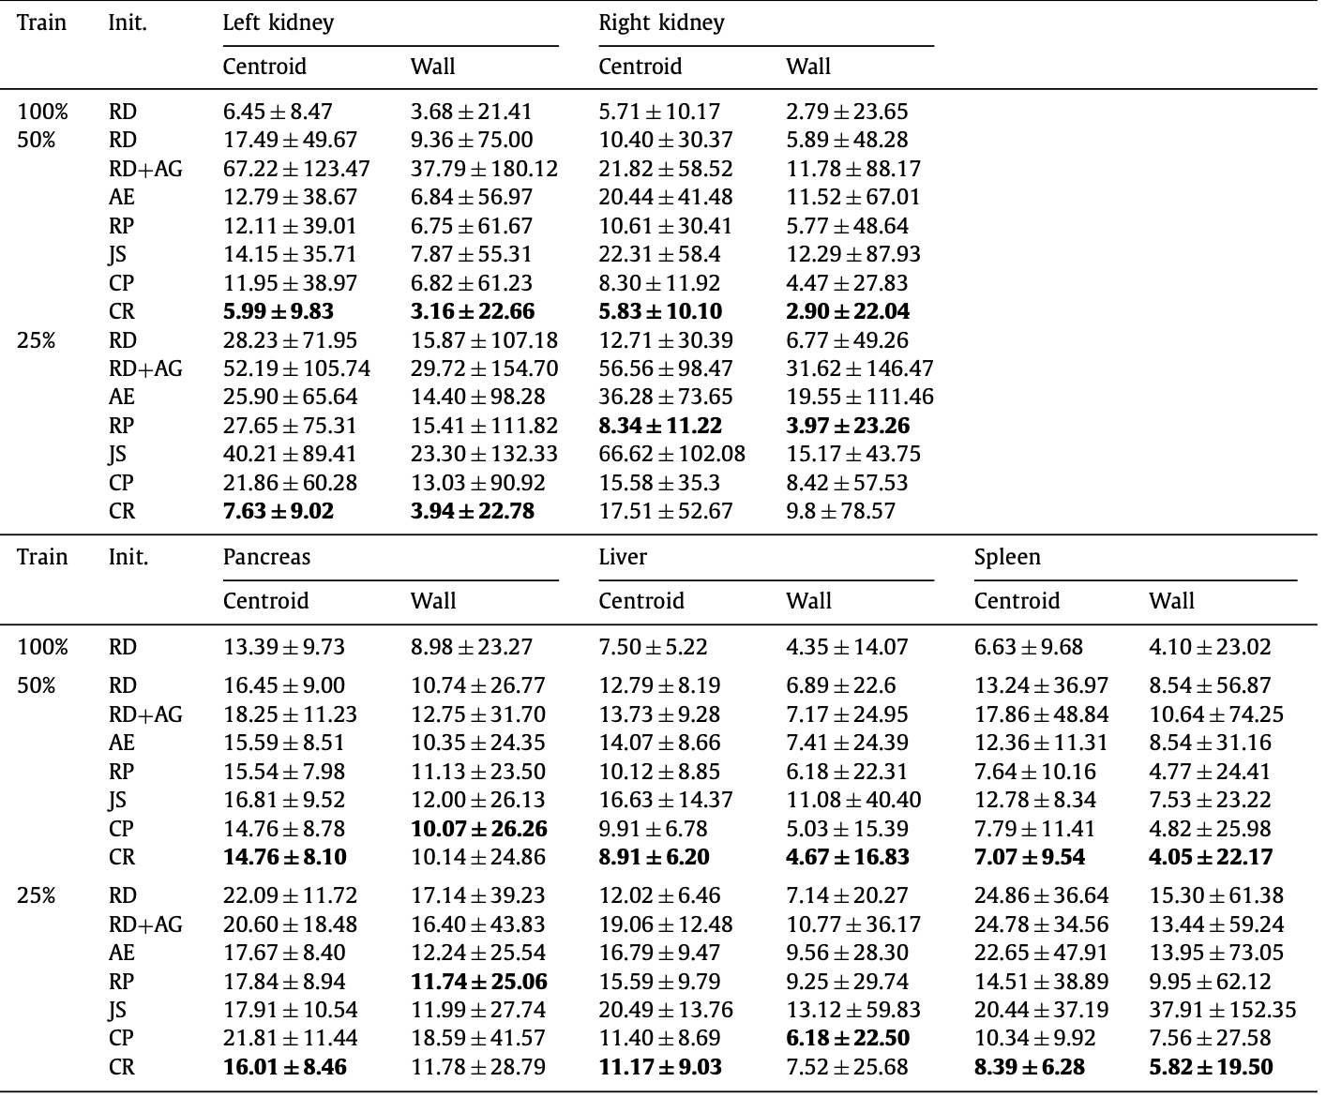
Experiment-Abdominal Multi-Organ Localization
Data Augmentation doesn’t help.
CR helps most.
Notes:
RP Shortcomings：1.relative position has multi result. 2.CNN learn trivial features. 3. not whole picture.

Slide 17
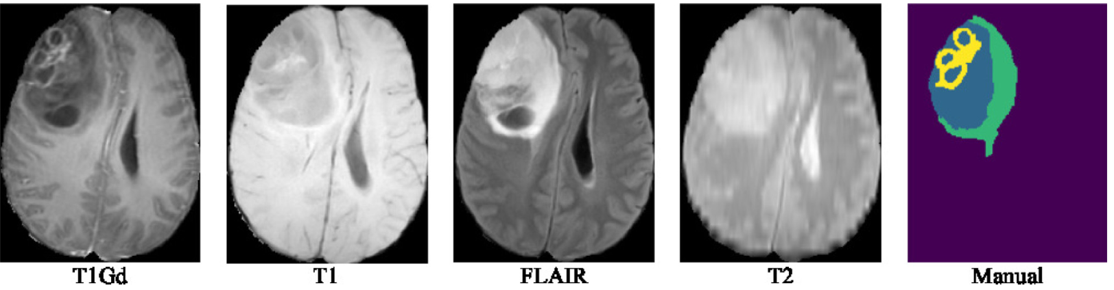
Experiment-Brain tumour segmentation
Network: Unet.
Dataset: BraTS 2017 challenge which consists of 285 subjects(four modalities).
Implementation: Based on patch with size 64*64.
Notes:
RP Shortcomings：1.relative position has multi result. 2.CNN learn trivial features. 3. not whole picture.

Slide 18
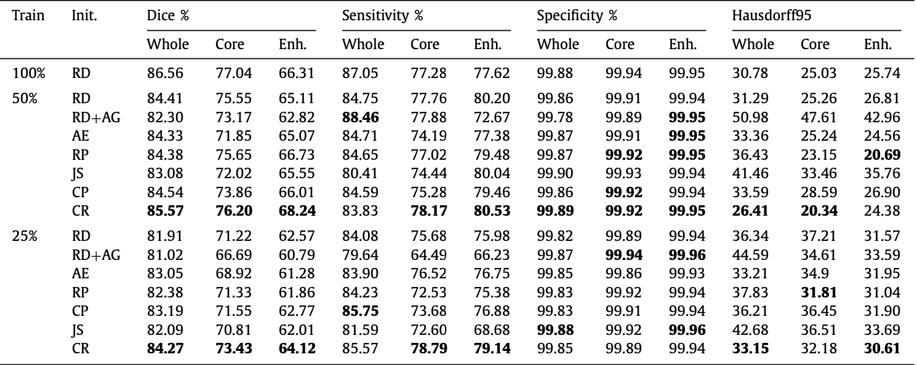
Experiment-Brain tumour segmentation
Data augmentation decrease the segmentation accuracy.
SSP helps improve the result and CR is most useful.
Notes:
RP Shortcomings：1.relative position has multi result. 2.CNN learn trivial features. 3. not whole picture.

Slide 19
Thank you (Q&A)
Notes:
RP Shortcomings：1.relative position has multi result. 2.CNN learn trivial features. 3. not whole picture.

